Slide 1
SCALATION in PYTHON

Slide 2
Implementing ScalaTion Concepts Using Python
Overview
While ScalaTion is a powerful Scala-based tool for simulation, optimization, and analytics, many of its core concepts and operations can be implemented using Python libraries.
This lesson will explore how to mimic ScalaTion's features using Python, focusing on data manipulation, transformation, and machine learning.

Slide 3
Objectives
By the end of this lesson, you will:
Understand how to replicate ScalaTion's data operations using Python.
Learn to perform advanced data transformations and analytics in Python.
Implement basic machine learning models in Python similar to those in ScalaTion.

Slide 4
Introduction to ScalaTion and Python Equivalents
ScalaTion provides a robust environment for high-performance data processing, especially with its column-oriented in-memory database and support for linear algebra operations.
In Python, you can achieve similar functionality using the following libraries:
Pandas: For data manipulation and analysis.
NumPy: For numerical operations and handling arrays/matrices.
SciPy: For advanced mathematical operations.
scikit-learn: For machine learning models.
Notes:
Pandas: Handles data manipulation and analysis with easy-to-use structures like DataFrames. Essential for cleaning and transforming data.
NumPy: Optimizes numerical operations and array handling, making computations faster and more efficient.
SciPy: Provides advanced mathematical tools for scientific computing, built on NumPy.
scikit-learn: Powers machine learning with simple implementations of algorithms for classification, regression, and more. Integrates well with Pandas and NumPy.
4o

Slide 5
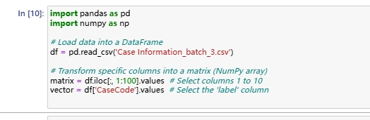
In this Python example, Pandas is used to load the data, and NumPy is used to convert specific columns into matrices or vectors, similar to ScalaTion's toMatriD and toVectorD methods.

Slide 6

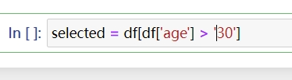
Basic Data Operations
Select Operation:
ScalaTion:
Python:

Slide 7


Project Operation:
ScalaTion:
Python:

Slide 8


Map Operation:
ScalaTion:
Python:
Notes:
A lambda function is an anonymous (or unnamed) function, which is used for short, simple operations. Here, the lambda function takes one input x (which represents each value in the 'Years' column) and adds 1 to it.
So, lambda x: x + 1 means: "For every x (each value in the 'Years' column), return x + 1."
In summary:
The .apply(lambda x: x + 1) part goes through each value in the 'Years' column and adds 1.

Slide 9


Join Operation:
ScalaTion:
Python:

Slide 10
In Python, Pandas provides a straightforward way to perform these operations with the groupby, apply, and merge functions.

Slide 11
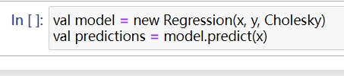
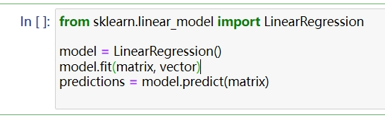
Machine Learning with Python
Linear Regression:
ScalaTion:
Python:
Notes:
Importing the Linear Regression model
sklearn.linear_model: This is part of the scikit-learn library, which contains various machine learning algorithms.
LinearRegression: This is the class that represents the linear regression model. It fits a straight line (or hyperplane in higher dimensions) to the data.
In Summary:
You import the linear regression model from scikit-learn.
You create an instance of the model.
You train the model using the fit() function with your data (matrix for features and vector for targets).
You predict new target values based on the input features using the predict() method.
This is the standard procedure for supervised learning, where the model is trained to map inputs (features) to outputs (targets).

Slide 12

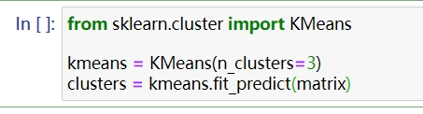
K-Means Clustering:
ScalaTion:
Python:
Notes:
In Python, scikit-learn provides a wide range of machine learning models that can be easily applied to matrices and vectors, similar to ScalaTion.

Slide 13
Performance Considerations
While ScalaTion is optimized for high performance with its in-memory columnar database, Python can achieve similar efficiency through:
Vectorization: Using NumPy for operations on arrays and matrices, which are highly optimized.
Parallel Processing: Utilizing libraries like Dask for distributed computing or Joblib for parallelizing tasks.
Efficient Data Structures: Leveraging Pandas for efficient data handling, especially with large datasets.

Slide 14
In Python, scikit-learn provides a wide range of machine learning models that can be easily applied to matrices and vectors, similar to ScalaTion.

Slide 15
Lets explore deeper Python scalation with using Covid-19 cases

Slide 16
Programming Interface
asdasdsadsdsd
User Program(python)
CSV
numpy
Handle Missing Data
Explore the Data
Data Analysis
SciPy
Matplotlib/Seaborn
Scalation modeling
Scikit-learn

Slide 17
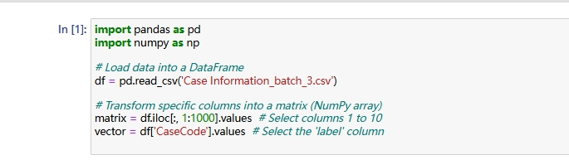
First, in Python, we need to first display the dataset to explore using necessary libraries.

Slide 18
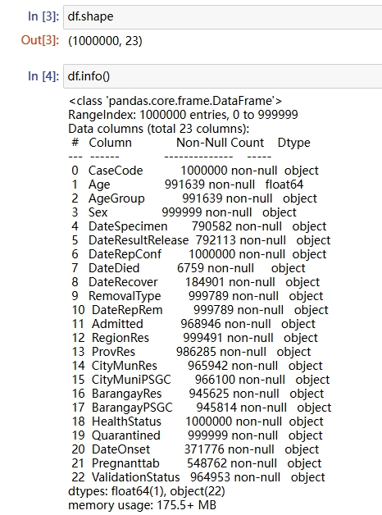
Before starting any data analysis, it is crucial to understand the characteristics of the data. In Scala programming, we do not need to explicitly specify the data type, whereas in Python, we use a method to determine the data type.

Slide 19
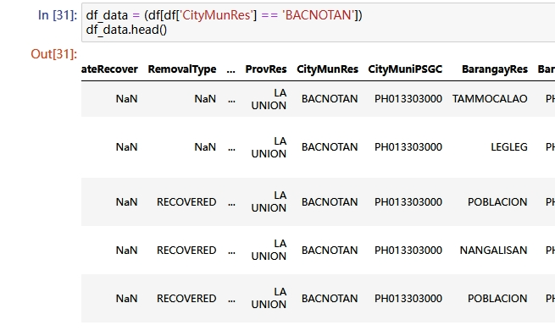
Filter the data in BACNOTAN that we focus on the SCALATION using python programing

Slide 20
Handling Missing Data
In your dataset, some columns have missing values. For example, Age has some missing entries, and columns like DateDied have very few entries. There are several strategies to handle missing data:
Imputation: Replace missing values with a computed value, such as the mean, median, or mode.
Dropping rows/columns: Remove rows or columns with too many missing values, particularly if those columns are critical for your analysis.

Slide 21
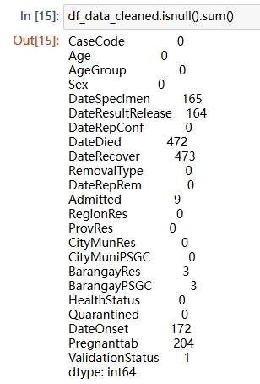
Using .isnull
Columns with No Missing Data:
CaseCode, Age, AgeGroup, Sex, DateRepConf, RegionRes, ProvRes, CityMunRes, CityMuniPSGC, HealthStatus, and Quarantined have no missing values. These columns are fully populated and ready for analysis.

Slide 22
Columns with Minor Missing Data:
DateSpecimen, DateResultRelease, DateOnset, and Pregnanttab have a small number of missing entries (ranging from 1 to 90). The missing data in these columns might be addressed through imputation, depending on their importance to your analysis.

Slide 23


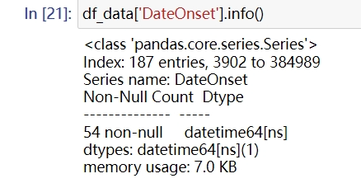
pd.to_datetime()
For numerical columns like DateDied, DateRecover, and DateOnset, you might fill missing values with the median or mean:
.fillna()
The missing data has to fill using median the median 2022-09-01
Notes:
We convert the appropriate data type for date onset we set into DATE TIME

Slide 24
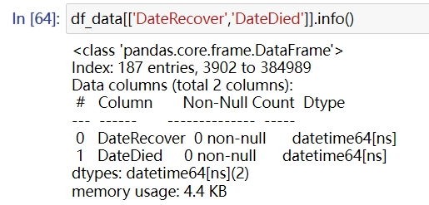
The fields DATEDIED and DATERECOVER are converted to the proper data type in order to explore or mine data through our dataset.

Slide 25
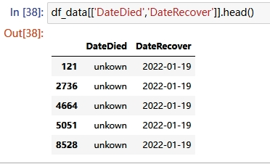
The missing data is filled with "unknown" and the missing date is recovered using the median because we are exploring the data using feature engineering.

Slide 26

For categorical columns like RemovalType, Pregnanttab, and ValidationStatus, you might fill missing values with the mode (most frequent value):
The missing data of removetype is RECOVERED
And the Pregnanttab is Unknown

Slide 27
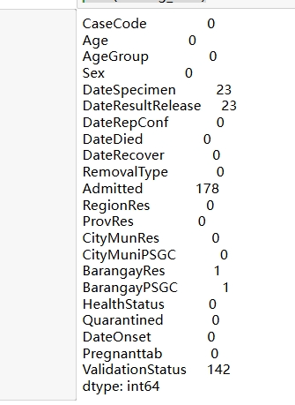
Columns with Minor Missing Data:
DateSpecimen, DateResultRelease, and have a small number of missing entries (ranging from 1 to 90). The missing data in these columns might be addressed through imputation, depending on their importance to your analysis.
Notes:
we fill first to mode and convert to proffer data type this columns

Slide 28
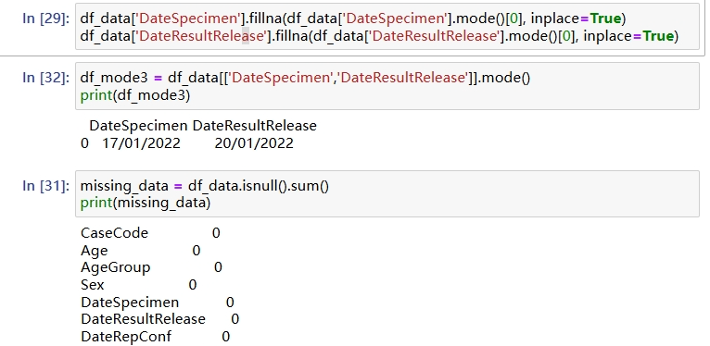
We filled in the missing data with the mode, so the dates are 17/01/2012 and 20/01/2022.

Slide 29
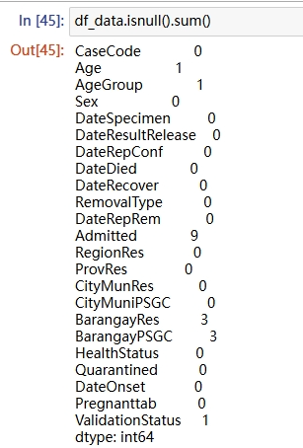
Categorical Columns ( Admitted, ValidationStatus): You might impute with a placeholder value like 'Unknown' or a specific category like 'Not Admitted'.

Slide 30
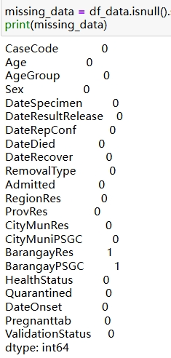
RegionRes, ProvRes, CityMunRes, CityMuniPSGC, BarangayRes, BarangayPSGC:
These columns are crucial for geographical analysis.
Notes:
Suggested Action: Consider imputing with the most common value (mode) or, if possible, cross-reference with other geographical columns.

Slide 31
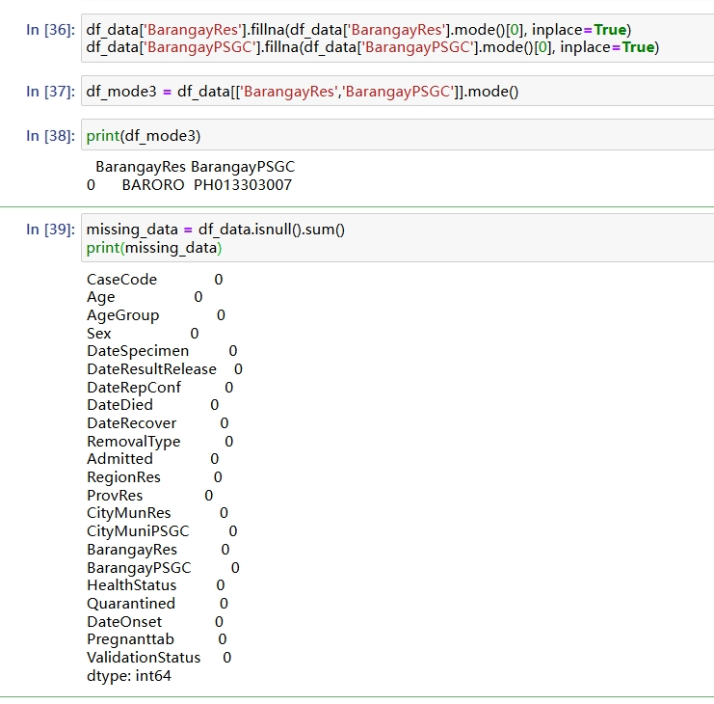
The missing data has been replaced. In column "barangayres", the data is filled with "BARORO" and the "barangayPSGC" is PH013303007.

Slide 32
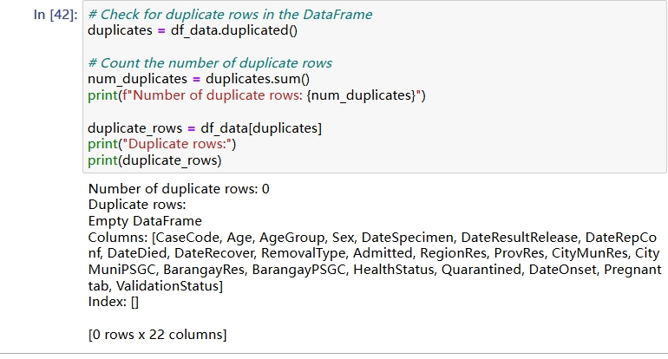
After cleaning the data, we need to check for duplicates to ensure the accuracy of our visualization and predictions. We use ‘.duplicated()’ function of pandas

Slide 33
2. Exploratory Data Analysis (EDA)
EDA is the process of analyzing datasets to summarize their main characteristics, often using visual methods. It helps in understanding the data distribution, spotting anomalies, and forming hypotheses for further analysis.

Slide 34
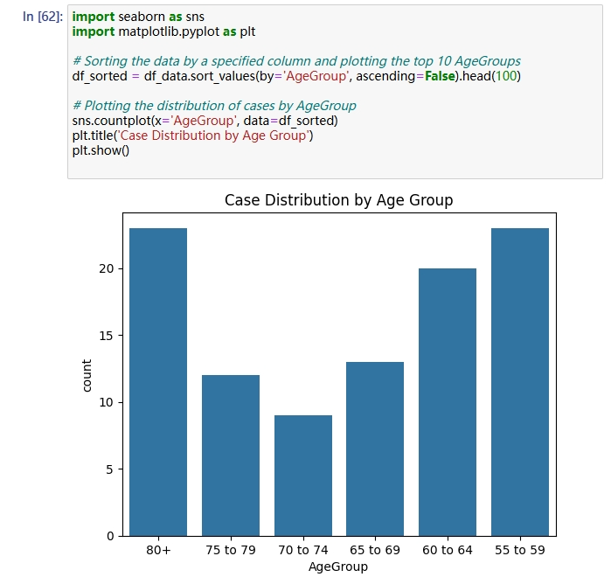
Using seaborn and matplotlib
The visualization shows the higher number of cases in the age group 80+ to 55 to 59. It helps in identifying which age groups have the highest number of cases and detects any unusual spikes or drops in specific age categories.

Slide 35
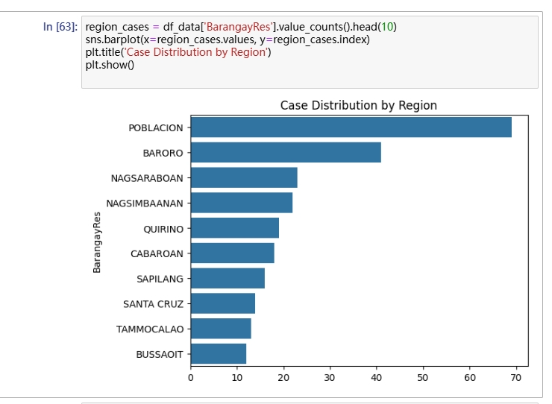
Please keep in mind the following information:
df['BarangayRes'].value_counts(): This function counts the number of cases per region.
sns.barplot: This method is used to visualize the counts, with regions on the y-axis for better readability, particularly when there are numerous regions.
Insights:
This approach helps identify regions with the highest and lowest number of cases.
It aids in comprehending regional variances and potential underlying causes.

Slide 36
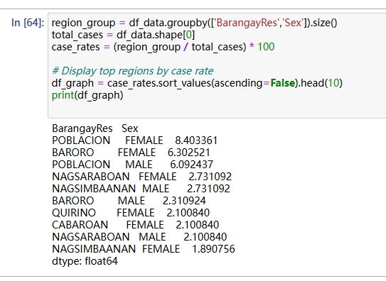
Using .groupby brgy and sex
Calculate Case Rates by barangay and sex
Purpose: Determining case rates by bgry and sex, allows for a relative comparison, accounting for population size or other regional factors that may influence case numbers.

Slide 37
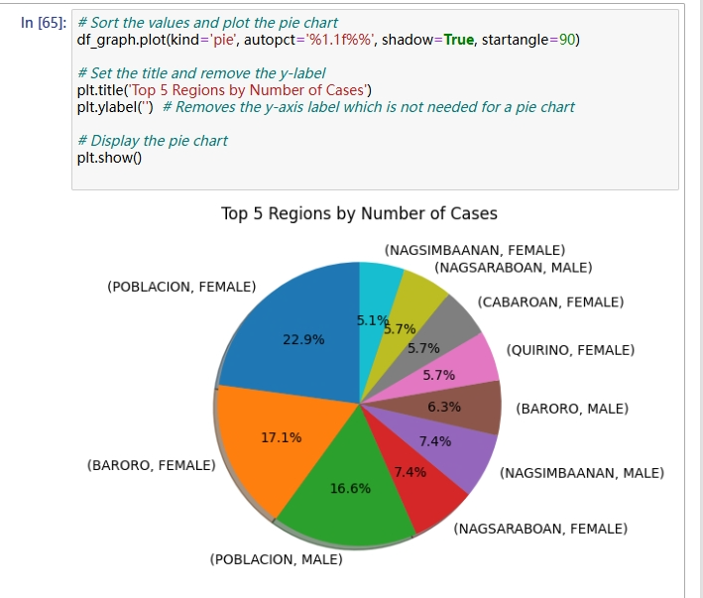
Notes:
So mostly brgy effect of pandemic is baroro and most affects gender is female has got 23.2 percent out off 100 percent

Slide 38
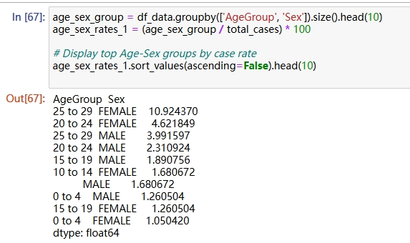
Identify High-Risk Groups (Age, Sex)
Purpose: Identifying high-risk demographic groups enables targeted public health interventions and resource distribution.
Insights:Reveals intersections of demographics that are disproportionately affected.
Highlights specific groups (e.g., elderly females) that may require focused interventions.

Slide 39
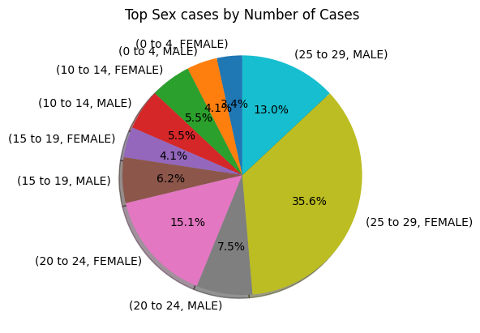
Notes:
Mostly the higher rate of cases is female has 25.9 percent out off 100 percent male age groupe to 20 to 24

Slide 40
Here is the revised text:"These are examples that illustrate how Python is used in data visualization. Python can combine columns of data to create useful graphs that explain the distribution of the data. Many different types of graphs are useful for data visualization, so it is up to you to choose the proper one that effectively tells a story to the audience."

Slide 41
Predicting Future Cases
Predictive modeling helps forecast future case numbers based on historical data, enabling proactive measures and planning.
Feature Engineering
Purpose: Creating new features from existing data can provide additional insights and improve the performance of machine learning models.

Slide 42
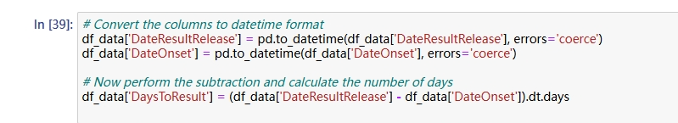
In this code, we are creating a formula to generate additional columns in the dataset. The date results show the onset date to create new data. We determine how many days of results are there, just like we dig into chunks of data to filter or create new valuable data for making predictions.

Slide 43
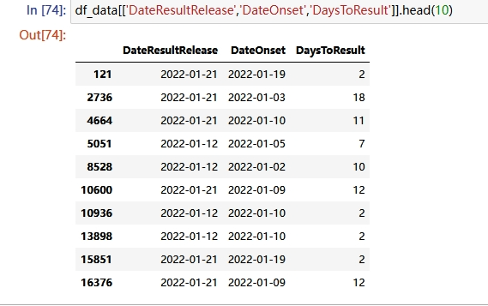
Notes:
pd.to_datetime(): This function is used to convert the specified columns (DateResultRelease and DateOnset) from object (string) data types to datetime objects.
errors='coerce': This argument ensures that any invalid or unparseable date values (e.g., incorrectly formatted dates or strings) are converted to NaT (Not a Time), which represents missing or invalid dates.
This conversion is necessary because dates stored as strings cannot be used directly in calculations. Once the data is converted into datetime objects, you can perform date arithmetic, like subtracting one date from another.
Perform the subtraction and calculate the number of days:
df_data['DateResultRelease'] - df_data['DateOnset']: This part calculates the difference between the two datetime columns. The result is a Timedelta object, which represents the time difference between the two dates.If DateResultRelease is later than DateOnset, the difference is positive (e.g., "5 days").
If either date is NaT, the result will be NaT for that row.
.dt.days: This extracts the difference in days from the Timedelta object and converts it into a simple integer representing the number of days between DateResultRelease and DateOnset.
The number of days between DateResultRelease and DateOnset is calculated for each row.Rows where either of the dates is missing (NaT) result in a NaN value in the DaysToResult column.

Slide 44
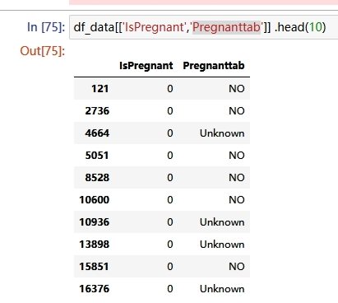
IsPregnant: Converts the 'Pregnanttab' column into a binary numerical feature.
Usefulness: Machine learning models require numerical inputs; binary encoding simplifies categorical variables with two states.

Slide 45
We have prepared the data for prediction, so let's use the sklearn model selection to train and test the data for predicting the specified data sets.

Slide 46
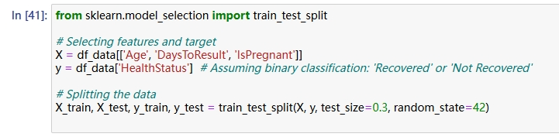
Step 2: Train-Test Split
Purpose: Splitting the data into training and testing sets allows you to evaluate the model's performance on unseen data, ensuring its generalizability.
Insights:Training Set: Used to train the model.
Testing Set: Used to evaluate the model's performance and detect overfitting.
Notes:
So this one has specific calculations throughout single data to predict the probability of health status

Slide 47
train_test_split: Divides the dataset into training and testing subsets.
test_size=0.3: Allocates 30% of the data for testing and 70% for training.
random_state=42: Ensures reproducibility of the split.

Slide 48
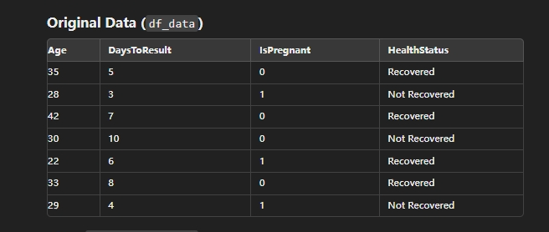
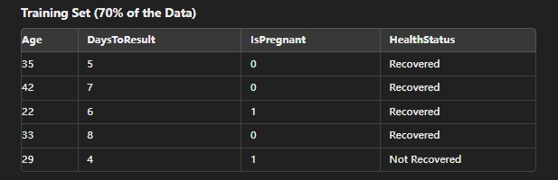
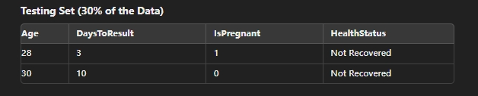

Slide 49
Explanation:
Training Set: 5 rows (70%) of the data are used to train the model. These rows help the model learn the relationship between the features (Age, DaysToResult, IsPregnant) and the target (HealthStatus).
Testing Set: 2 rows (30%) of the data are kept aside for testing. These rows are used to evaluate the performance of the trained model.
This split ensures that the model is tested on unseen data, which is essential to assess its ability to generalize to new, real-world data.

Slide 50
We just finished the model to the prediction so we have applied the algorithm of the data set we have tried to use the random forest classifier
To initialize the train model through our data set.

Slide 51
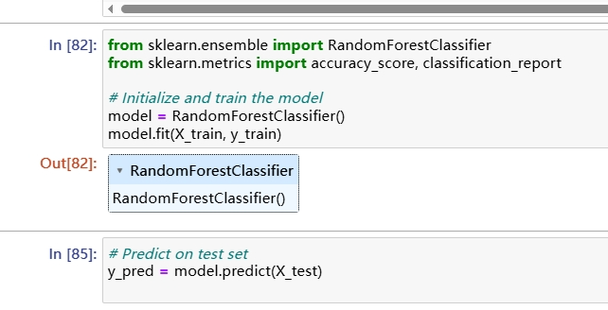
Step 3: Model Training and Prediction
Purpose: Training a machine learning model enables the prediction of future cases based on learned patterns from historical data.
RandomForestClassifier: An ensemble learning method that operates by constructing multiple decision trees.
Advantages:
Handles both numerical and categorical data.
Robust to overfitting, especially with large datasets.
Provides feature importance metrics.
model.predict: Generates predictions for the test data.

Slide 52
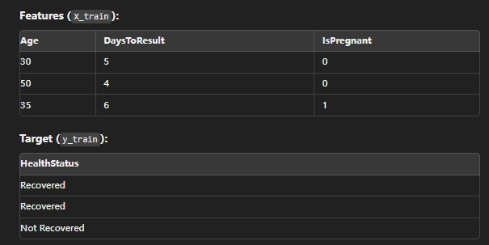
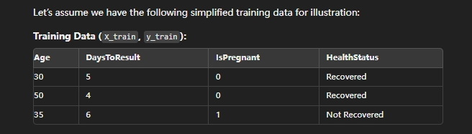
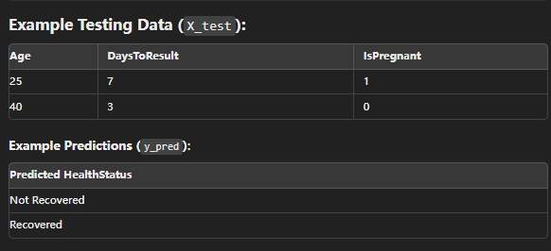
Notes:
RandomForestClassifier is a machine learning model used for classification tasks. It builds multiple decision trees and merges them to get a more accurate and stable prediction.
Initializing the Model:
This creates an instance of the RandomForestClassifier with default parameters. You can customize it later if needed.
Training the Model:
fit method trains the model on the training data (X_train and y_train). The model learns the patterns in the data and builds the decision trees based on these patterns.
Process
Initialization: A RandomForestClassifier object is created.
Training: The fit method uses the training data (X_train, y_train) to build the model.

Slide 53
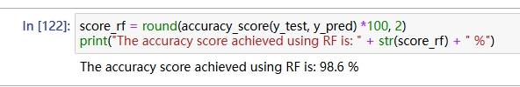
accuracy_score: Measures the proportion of correctly predicted instances.
classification_report: Provides detailed metrics like precision, recall, and F1-score for each class.
Notes:
we have used random forest the accuracy score is 78% percent

Slide 54
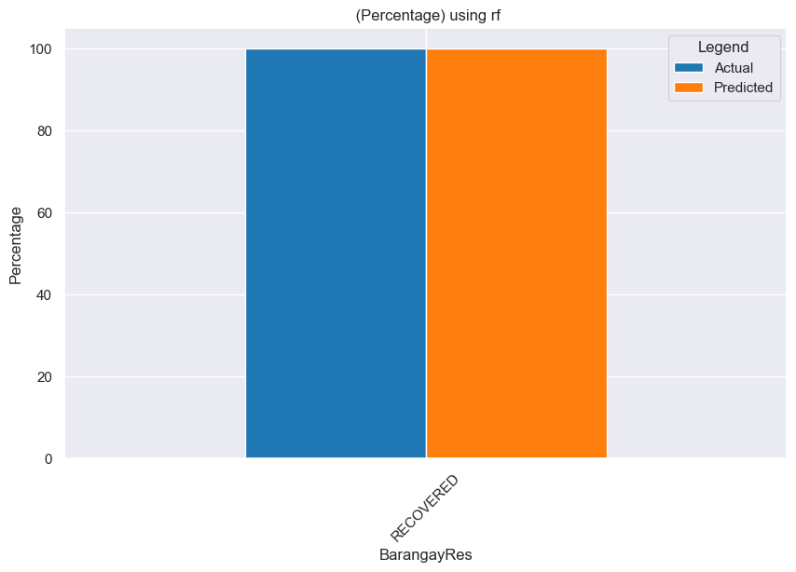

Slide 55
We have summarized all the algorithms used in data. In data science, the higher the accuracy of the model, the better the predictions.

Slide 56
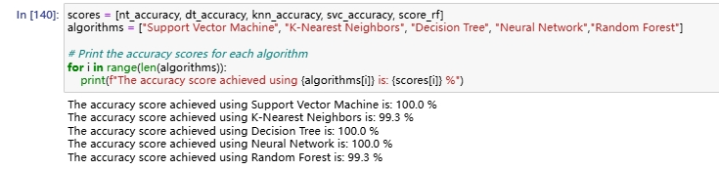
Notes:
The summary shows the higher score is the decision tree so the most accurate prediction is decision tree

Slide 57
